Slide 1
Deep learning techniques for diagnosing plant diseases
-Mohammad Habibullah

Slide 2
Outlines
Introduction
Methodology
Results
Discussion
Conclusion

Slide 3
Introduction

Slide 4
Introduction
Crop diseases are a major threat to food security
13% of global potential crop yield is lost to diseases each year
Current approaches are predominantly visual and require specialized training
Such techniques are hindered by subjectivity
Rapid and accurate identification is needed

Slide 5
Deep learning
Deep learning [1] is part of machine learning based on the layers used in artificial neural networks
Deep learning has paved the way for smartphone-assisted disease diagnosis
[2] applied CNN to identify 14 crop species and 26 diseases
[3] identified 13 different types of plant diseases out of healthy leaves using DL
[4] used CNN to classify 58 different classes of 25 plant species
LeCun, Y., Bengio, Y., & Hinton, G. (2015). Deep learning. nature, 521(7553), 436.
Mohanty, S. P., Hughes, D. P., & Salathé, M. (2016). Using deep learning for image-based plant disease detection. Frontiers in plant science, 7, 1419.
Sladojevic, S., Arsenovic, M., Anderla, A., Culibrk, D., & Stefanovic, D. (2016). Deep neural networks based recognition of plant diseases by leaf image classification. Computational intelligence and neuroscience, 2016.
Ferentinos, K. P. (2018). Deep learning models for plant disease detection and diagnosis. Computers and Electronics in Agriculture, 145, 311-318.

Slide 6
Scope of work
Images for building the models-
[2] used 54,306 images
[3] used 33,469 images
[4] used 87,848 images
Creating large dataset for different species of plants is difficult
Large dataset modeling takes a lot of computational power
Less accuracy for small dataset
Overfitting problem for small dataset
2. Mohanty, S. P., Hughes, D. P., & Salathé, M. (2016). Using deep learning for image-based plant disease detection. Frontiers in plant science, 7, 1419.
3. Sladojevic, S., Arsenovic, M., Anderla, A., Culibrk, D., & Stefanovic, D. (2016). Deep neural networks based recognition of plant diseases by leaf image classification. Computational intelligence and neuroscience, 2016.
4. erentinos, K. P. (2018). Deep learning models for plant disease detection and diagnosis. Computers and Electronics in Agriculture, 145, 311-318.

Slide 7
Project Objectives
Identifying plant diseases using deep learning
Train a model using small dataset
Exploring different techniques to improve accuracy
Techniques to tackle overfitting problem

Slide 8
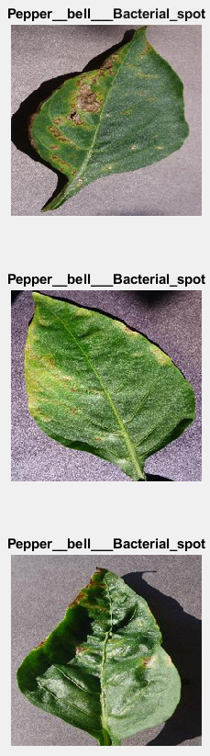
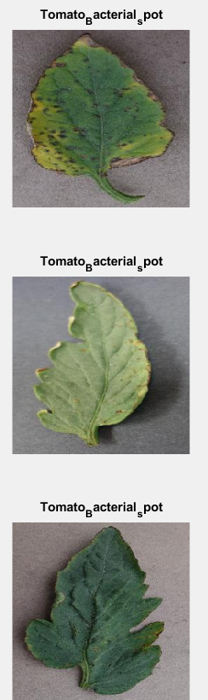
Plant dataset
Collected the dataset from crowdAI (https://www.crowdai.org/challenges/1)
Number of images - 4,125
Number of disease classes to identify - 15
Pepper bell Bacterial spot
Pepper bell healthy
Potato Early blight
Potato healthy
Potato Late blight
Tomato Bacterial spot
Tomato Early blight
Tomato healthy
Tomato Late blight
Tomato Leaf Mold
Tomato Septoria leaf spot
Tomato Spider mites Two spotted spider mite
Tomato Target Spot
Tomato Tomato mosaic virus
Tomato Tomato Yellow Leaf Curl Virus
Figure : images from dataset

Slide 9
Methodology

Slide 10
Strategies
Convolutional Neural Network (CNN) approach
CNN with image augmentation technique
Transfer learning – GoogleNet

Slide 11
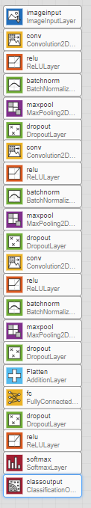
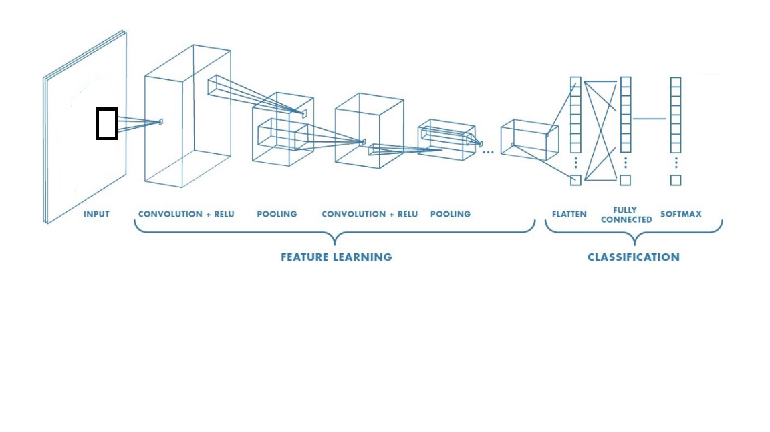
Strategy1-CNN
Architecture:
5 convolutional layer
6 relu activation layer
6 batch normalization layer
3 maxpool layer
4 dropout layer
1 flatted layer
2 dense layer
1 softmax layer
Figure : CNN architecture

Slide 12
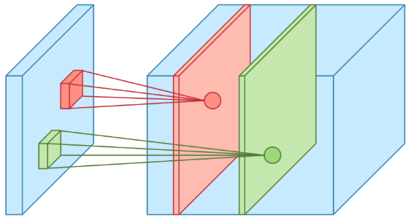
Strategy1-CNN
Filter 1
Filter 2
Input layer :
Same as the input image : 256x256x3
Conv layers:
Conv1 : filter size 32, filter 3x3 , stride 1
Conv2 : filter size 64, filter 3x3 , stride 1
Conv3 : filter size 64, filter 3x3 , stride 1
Conv4 : filter size 64, filter 3x3 , stride 1
Conv5 : filter size 128, filter 3x3 , stride 1
Figure : Convolution layer

Slide 13
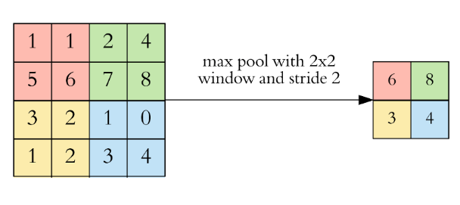
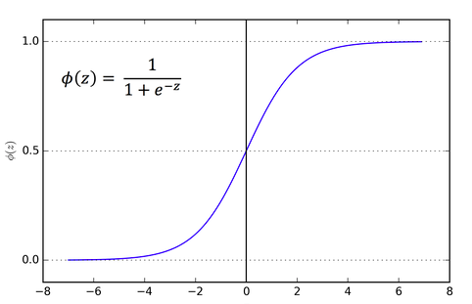
Strategy1-CNN
Maxpooling layer:
For reducing dimensionality
Down sample each feature map independently
Linear activation unit –ReLu layer:
Sigmoid function
It maps the resulting values in between 0 to 1

Slide 14
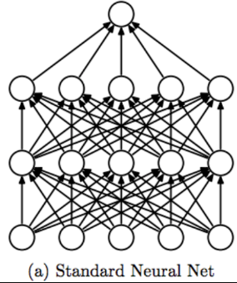
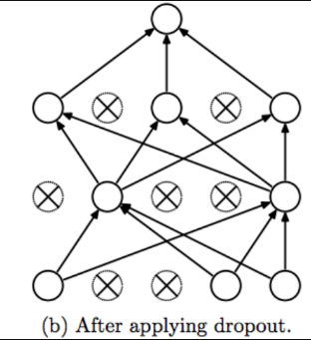
Strategy1-CNN
Batch normalization layer:
Batch normalization normalizes the output of a previous activation layer by subtracting the batch mean and dividing by the batch standard deviation.
Dropout layer :
Some number of layer outputs are randomly ignored or dropped out.
Reduce overfitting [5]
5. Srivastava, N., Hinton, G., Krizhevsky, A., Sutskever, I., & Salakhutdinov, R. (2014). Dropout: a simple way to prevent neural networks from overfitting. The Journal of Machine Learning Research, 15(1), 1929-1958.

Slide 15
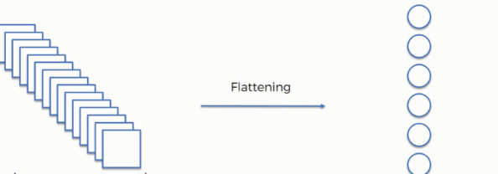
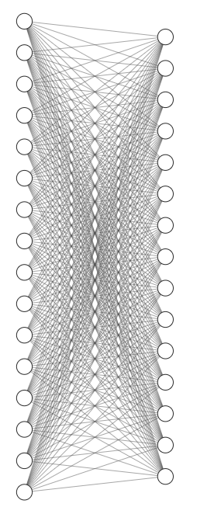
Strategy1-CNN
Flatten layer :
Flatten the pooled feature map into a column like image
Dense layer
Fully connected layer
2 dense layer has been used
Dense 1 has 1024 neurons
Final layer has 15 neuron equals output class

Slide 16
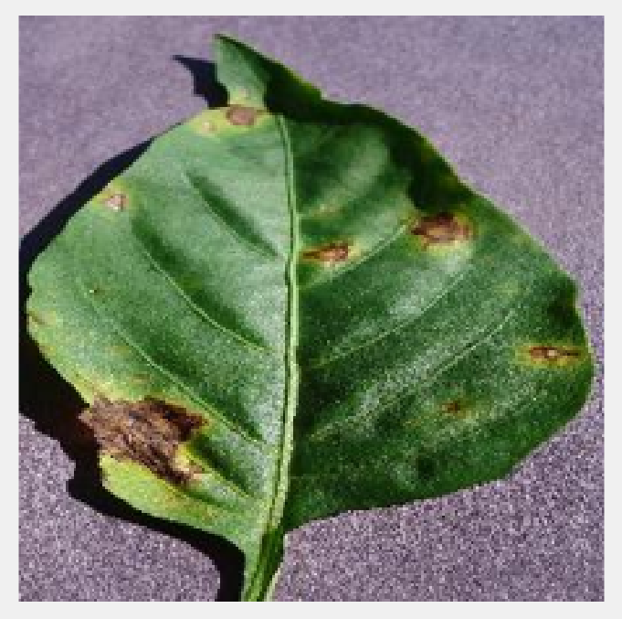
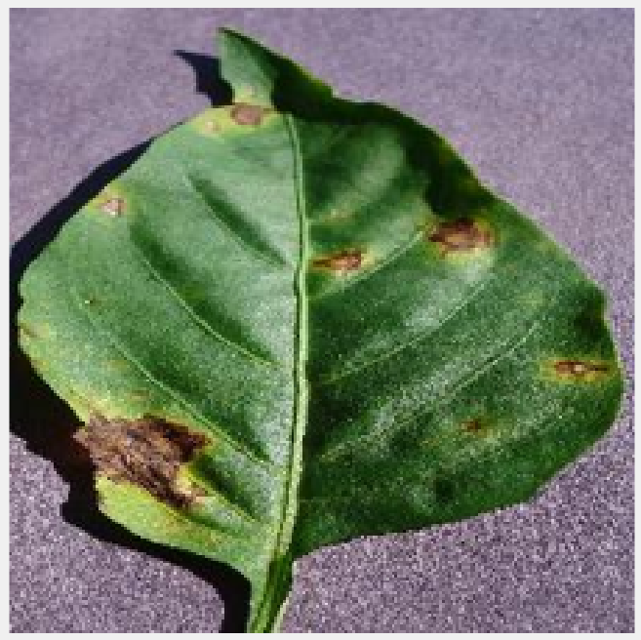
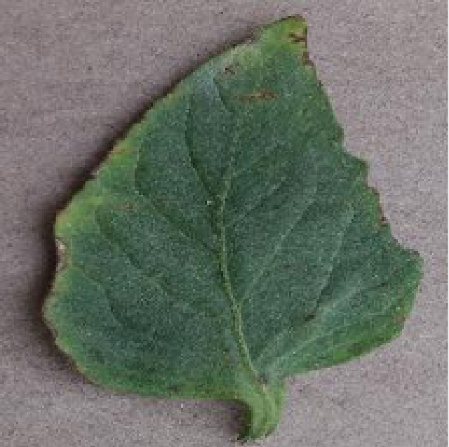
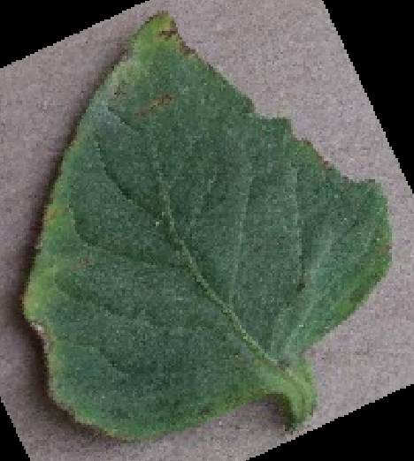
Strategy2-CNN with image augmentation
Horizontal Flip
Reduce overfitting on image dataset to enlarge the dataset manually[6]
Procedure-
Horizontal flip
Vertical flip
Random zooming up to 0.2
Adjusting the brightness of image
Adjusting the hue of image
Random rotation range 25 degree
Random rotation
6. Perez, L., & Wang, J. (2017). The effectiveness of data augmentation in image classification using deep learning. arXiv preprint arXiv:1712.04621.

Slide 17
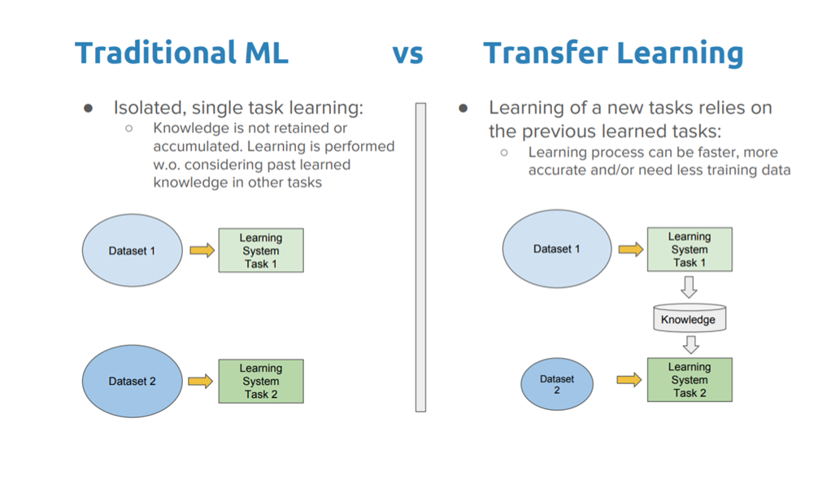
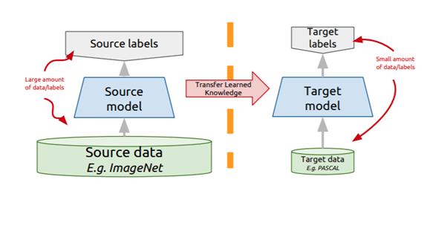
Strategy3- Transfer learning
A machine learning method where a model developed for a task is reused on another model for a different task
Pretrained on a large available dataset and use the model to train a small dataset
It works best for similar type of task
Examples- AlexNet, googleNet, ResNet etc.

Slide 18
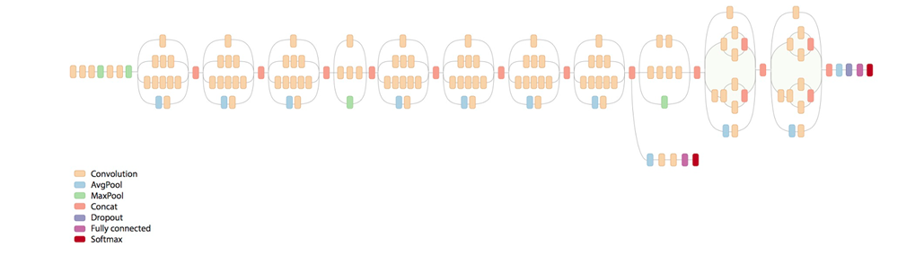
Strategy3- Transfer learning
GoogleNet:
Deep learning architecture for image recognition
Winner of 2014 ILSVRC competition
Consists of 22 layers
Trained on 1.2 million images of 1000 classes

Slide 19
Strategy3- Transfer learning
Modification of pre-trained GoogleNet:
Image input layer is changed accordingly
The last two fully connected layers were reset
Change the output put layer to 15 neurons
Freezing the weights and biases of the first 10 convolution layers
Freezing the weights significantly speeds up network training
As data set is small it prevents those layers from overfitting to the new data set.

Slide 20
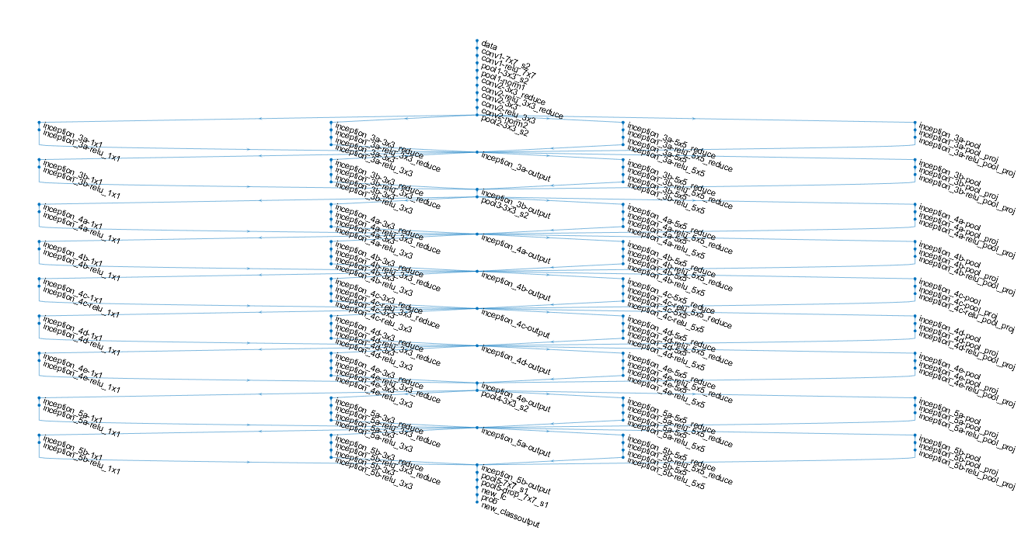
Strategy3- Transfer learning
Figure: GoogleNet architecture

Slide 21
Results

Slide 22
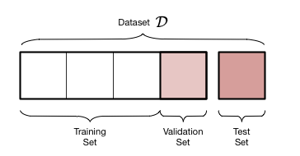

Results
Data splitting:
Hold out method
Training - 2,887 (70%)
Validation- 827 (20%)
Testing- 411 (10%)
Evaluation metrices :
Accuracy
Confusion matrix
Training and validation accuracy vs epoch
Training and validation loss vs epoch

Slide 23
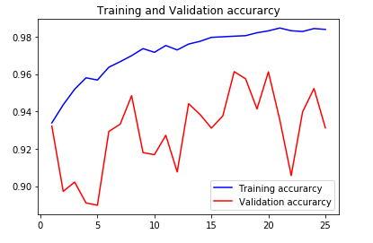
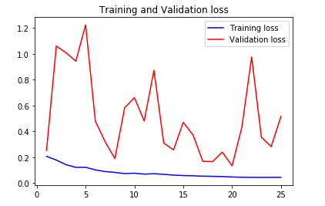
Results of strategy1
Testing accuracy : 73.56%

Slide 24
Results of strategy1
Prediction class
[25, 6, 1, 0, 0, 0, 2, 0, 1, 2, 0, 0, 0, 0, 0],
[ 0, 26, 0, 0, 0, 0, 1, 0, 0, 0, 0, 0, 0, 0, 3],
[ 0, 0, 23, 0, 0, 0, 0, 0, 0, 0, 0, 0, 0, 0, 6],
[ 0, 0, 0, 27, 0, 0, 0, 1, 0, 0, 2, 1, 1, 0, 3],
[ 0, 4, 0, 0, 2, 0, 0, 0, 0, 0, 0, 0, 0, 0, 3],
[ 0, 0, 0, 0, 0, 17, 4, 0, 0, 0, 0, 0, 0, 0, 4],
[ 0, 2, 2, 0, 0, 0, 18, 0, 1, 0, 0, 0, 0, 0, 7],
[ 0, 0, 2, 1, 0, 0, 0, 14, 0, 0, 0, 0, 0, 0, 6],
[ 0, 0, 0, 0, 0, 0, 0, 0, 29, 0, 0, 0, 0, 0, 4],
[ 0, 1, 2, 0, 0, 0, 0, 0, 9, 16, 0, 0, 0, 0, 6],
[ 0, 0, 0, 0, 0, 0, 0, 0, 0, 5, 16, 0, 1, 0, 0],
[ 0, 0, 0, 0, 0, 1, 0, 0, 0, 0, 2, 18, 0, 0, 1],
[ 0, 0, 0, 0, 0, 2, 1, 0, 0, 0, 0, 0, 19, 0, 2],
[ 0, 0, 0, 0, 0, 0, 0, 0, 0, 0, 0, 0, 1, 22, 5],
[ 0, 0, 0, 0, 0, 0, 0, 0, 0, 0, 0, 0, 0, 0, 23],
Actual class

Slide 25
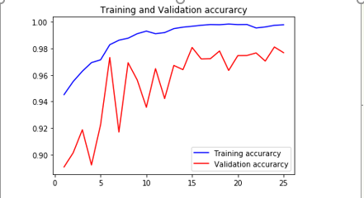
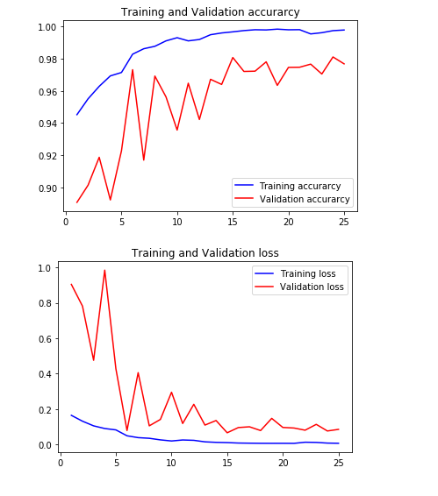
Results of strategy2
Testing accuracy : 84.53%

Slide 26
Results of strategy2
Prediction class
[31, 3, 0, 0, 0, 0, 0, 0, 1, 1, 0, 0, 1, 0, 0],
[ 3, 26, 0, 0, 1, 0, 0, 0, 0, 0, 0, 0, 0, 0, 0],
[ 3, 1, 24, 1, 0, 0, 0, 0, 0, 0, 0, 0, 0, 0, 0],
[ 3, 0, 0, 23, 1, 0, 1, 1, 1, 0, 0, 1, 1, 0, 0],
[ 0, 0, 0, 1, 7, 0, 0, 1, 0, 0, 0, 0, 0, 0, 0],
[ 0, 0, 0, 0, 0, 22, 0, 0, 0, 0, 0, 0, 1, 0, 2],
[ 1, 0, 0, 0, 0, 0, 26, 2, 0, 0, 0, 0, 1, 0, 0],
[ 1, 0, 0, 0, 0, 1, 3, 16, 0, 0, 0, 0, 1, 0, 1],
[ 0, 0, 0, 0, 0, 0, 0, 0, 31, 2, 0, 0, 0, 0, 0],
[ 1, 0, 0, 0, 1, 0, 0, 3, 1, 21, 0, 1, 3, 2, 1],
[ 1, 0, 0, 0, 0, 0, 0, 0, 1, 0, 20, 0, 0, 0, 0],
[ 1, 1, 0, 0, 0, 0, 0, 1, 0, 1, 1, 17, 0, 0, 0],
[ 0, 0, 0, 0, 0, 0, 0, 0, 0, 0, 0, 0, 24, 0, 0],
[ 0, 0, 0, 0, 0, 0, 0, 0, 0, 0, 0, 0, 0, 28, 0],
[ 0, 0, 0, 0, 0, 0, 0, 0, 0, 0, 0, 0, 0, 0, 23],
Actual class

Slide 27
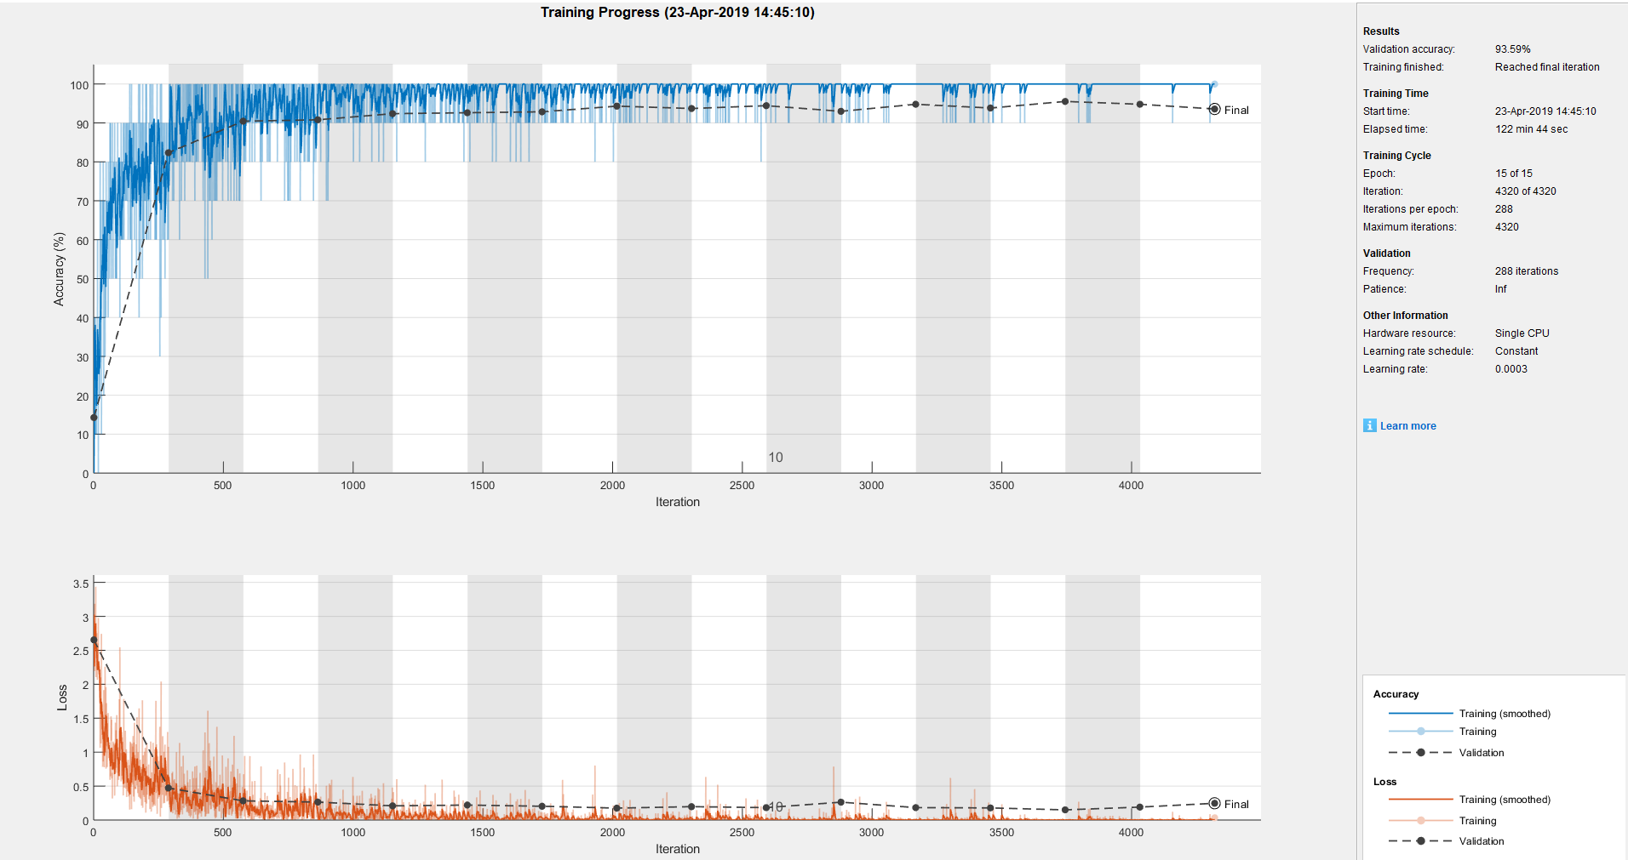
Results of Strategy3

Slide 28
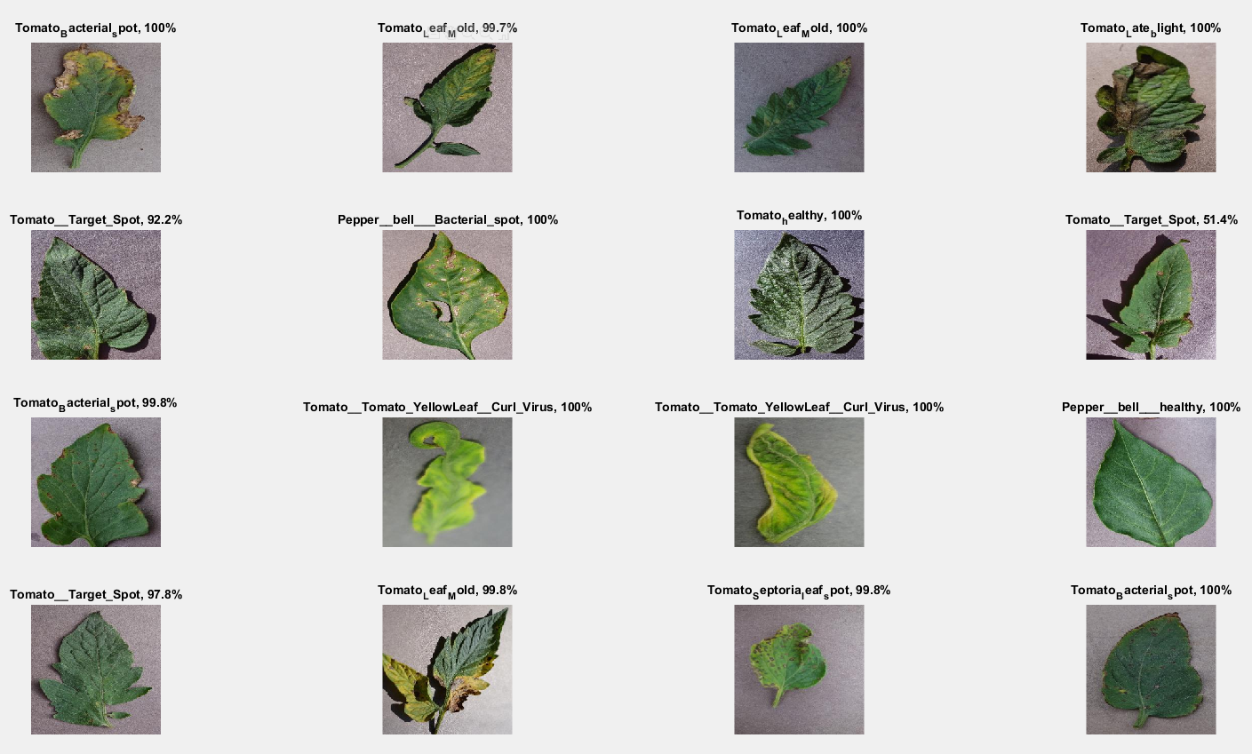
Results of Strategy3
Testing accuracy : 94.40%

Slide 29
Discussion
Strategy1-CNN:
This model showed the lowest testing accuracy of 73.56%.
Large difference between validation accuracy and test accuracy
Strategy2-CNN with image augmentation:
Significant improvement of testing accuracy : 84.53%
This technique increased the ability of the model to generalize
Strategy3- Transfer learning(GoogleNet)
This retrained model showed the highest accuracy of 94.40%
Training, validation and testing accuracy are closer meaning no overfitting

Slide 30
Conclusion
The objective –
Identify plant diseases using deep learning
Good accuracy with small dataset
Challenges-
Overfitting
Low testing accuracy by basic CNN (strategy1)
Project outcomes-
Tackled overfitting by data augmentation in strategy 2 (Testing accuracy 84.53%)
Strategy3 (Pretrained Google Net) showed best testing accuracy (94.40%)
Future work:
Applying similar techniques to other available dataset
Identified more variant of species

Slide 31
Questions

